Slide 1

Posture recognition using body location sensors
Capstone Two Project, June 2020 Cohort
Prashant gupta
Mentor: Mr. Arindam Mondal

Slide 2

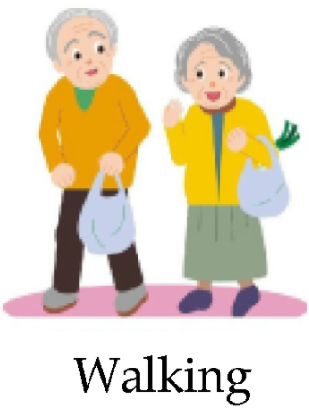
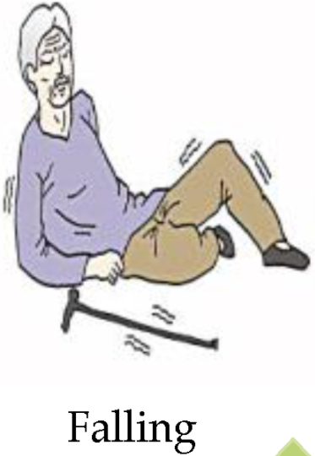

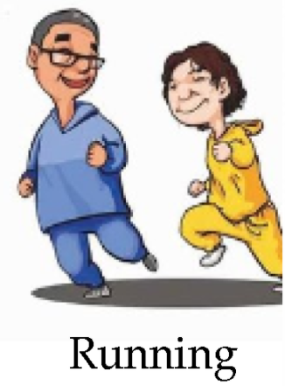
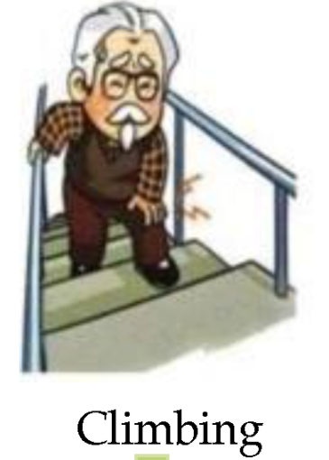
Motivation for the study – The Problem
Notes:
This is Joe. Joe is 80 years old and wants to live independently because he does not wants to be the burden on his children.
Joe has a dynamic daily routine. He walks to the nearest grocery shop to buy necessities and also runs sometime for healthy body.
He does climb stairs from his room to terrace for fresh air and also various other activities.
Joe and his family members are afraid of one thing which is “WHO IS GOING TO HELP HIM WHEN HE FALLS.”

Slide 3
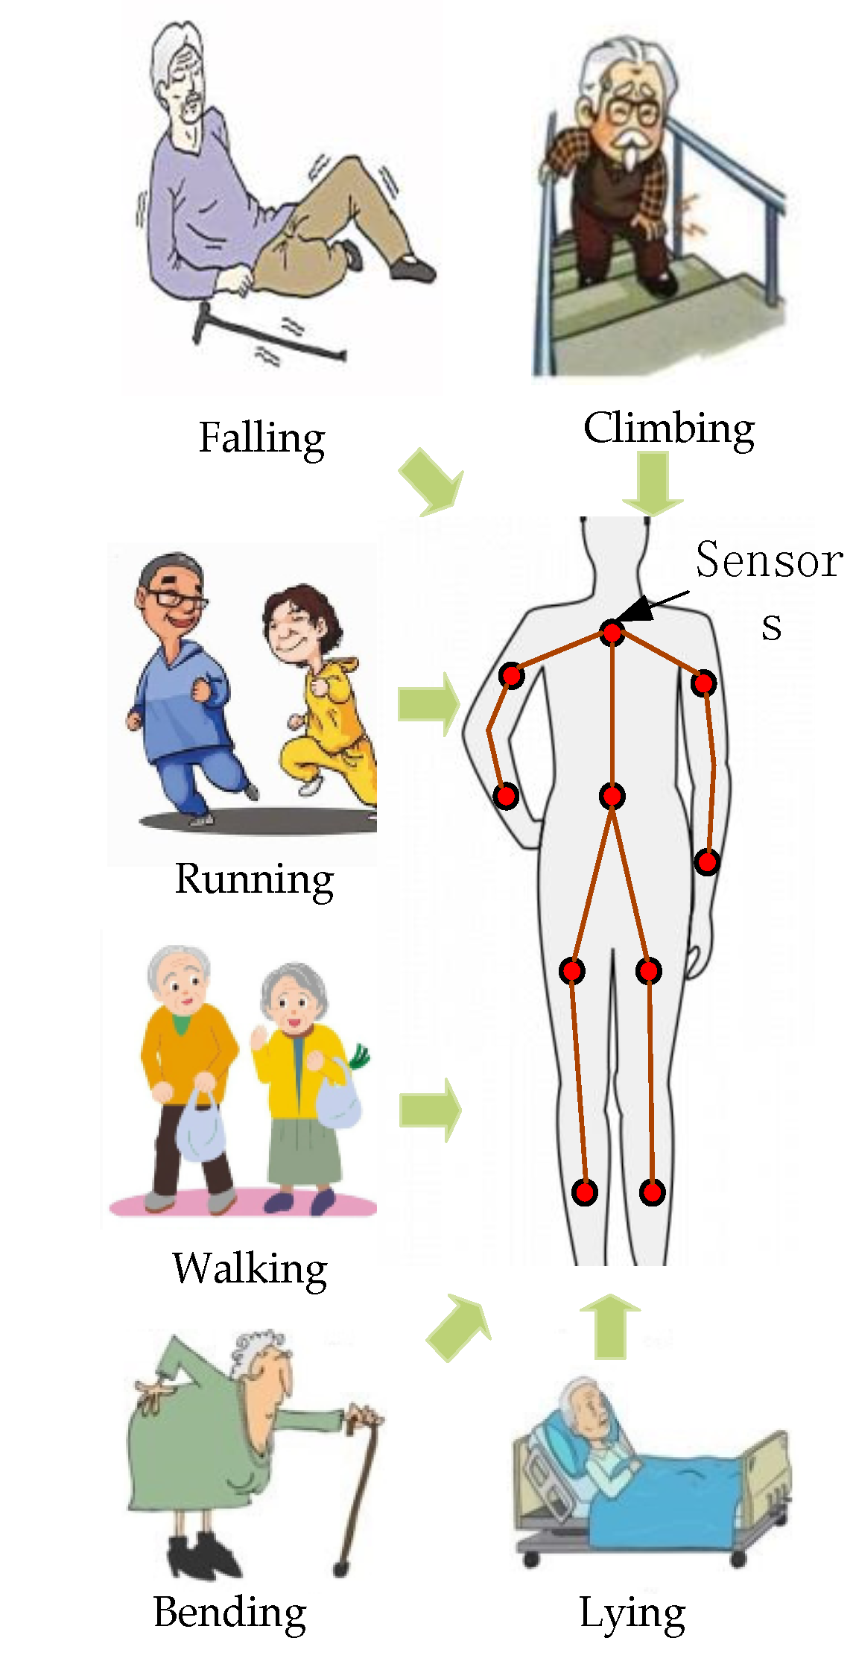
How Can we Save Joe?
Wearing Sensors on body parts
Sensors gives real time location of the person’s body parts
Those locations can be converted into velocities and other information which gives idea about the activity person is doing
The primary concern for the independent living of elderly people is to provide the immediate medical support in case of emergency like falling or fainting
Notes:
We can save Joe by detecting when he falls and immediately informing the emergency medical care and his family members.
For that Joe has to wear sensors through which we can identify what he is doing.

Slide 4




WHO Might Care?
First Aid Centre
Medical Research Institute
Nursing Centre
Day Care Centre for Elderly
Old Age Homes
National Council for Senior Citizens
Family Members
…. and many more….

Slide 5
Data Information
There are eleven classification of activities
walking
falling
sitting down
standing up from lying
on all fours
sitting on the ground
standing up from sitting
standing up from sitting on the ground
Sensors have been placed at 4 locations on body
Chest
Belt
Left Ankle
Right Ankle
Each Sensor record the position
x
y
z
lying down
lying
sitting

Slide 6
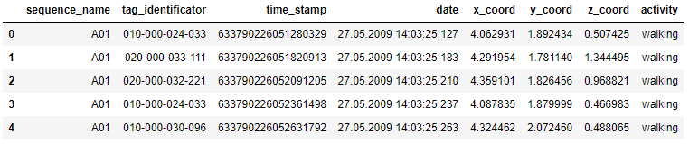
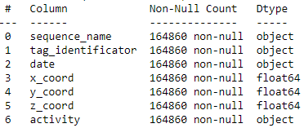
Data Information

Slide 7
PROCESS MAP for predicting activity
Input Data
Data Cleaning
Feature Engineering
Training of ML Algorithm
Computing Accuracy
Metrics Evaluation
Recommended Algorithm
Data of Body Sensors
X
Y
Z
Removal of outliers
Filtering the noise (Kalman Filter)
Calculation of Attributes like velocities, angle etc.
Train-Test Split
Standardization of features
Hyperparameter tuning
10-fold Cross validation
Accuracy of test dataset
Calculation of Precision, Recall and F1-score for falling class
Chosing best algorithm based on model metrics evaluation

Slide 8
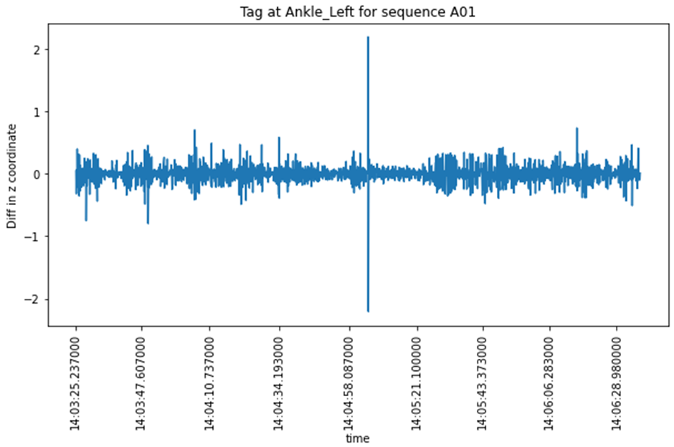
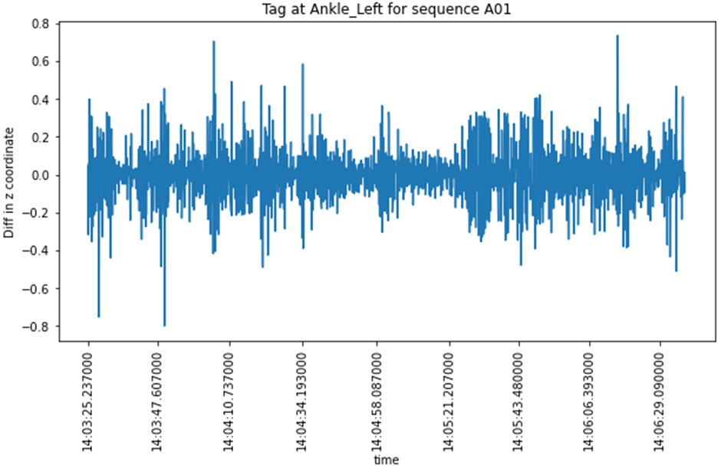
Data Wrangling
There are certain outliers which can be seen as big spikes
The outliers are removed where the difference between previous position and next position is large
Data Cleaning

Slide 9
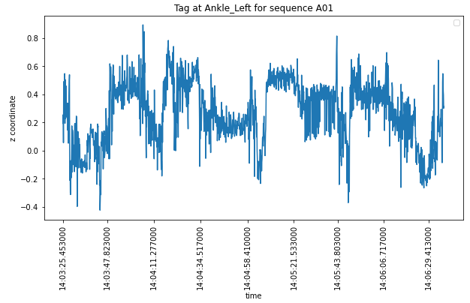
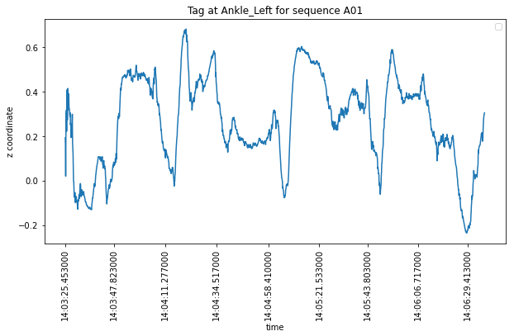
Noise Processing
Another process of data cleaning is to remove the noise in the data. Noises in the sensors are processed by Kalman Filter Algorithms
Kalman Filter
ML algorithms are trained on both noisy and clean data

Slide 10
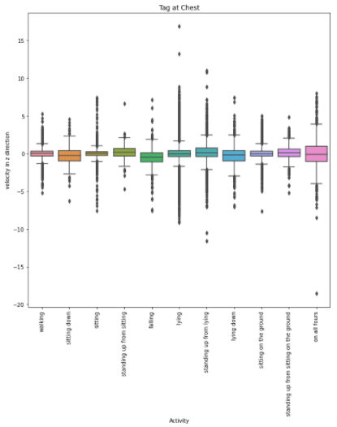
Exploratory Data Analysis
For falling activity velocities are large than other class

Slide 11
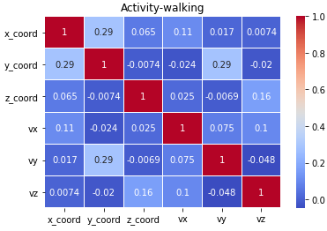
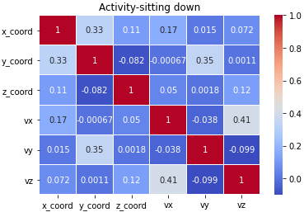
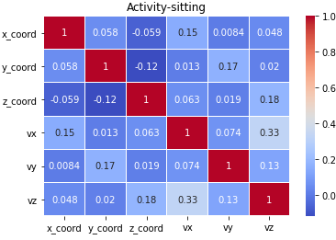
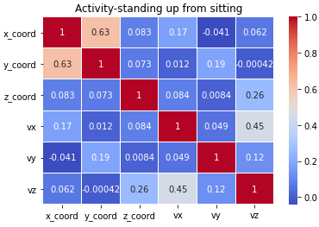
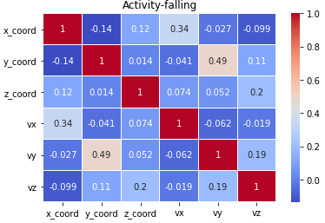
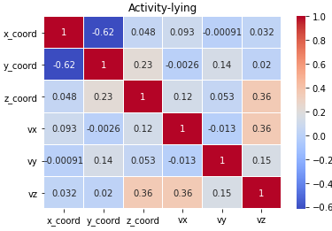
Exploratory Data Analysis
Correlation matrix between different variables for each class

Slide 12
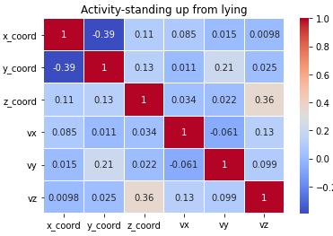
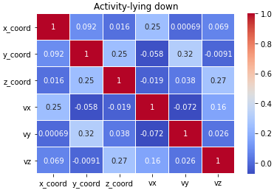
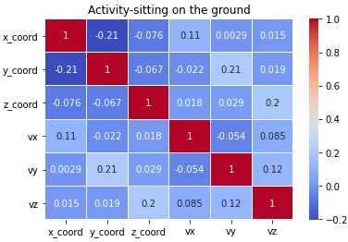
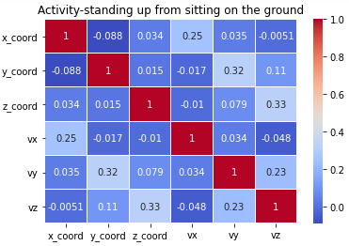
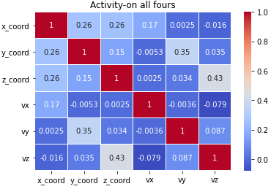
Exploratory Data Analysis
Correlation matrix between different variables for each class

Slide 13
Feature Engineering
Three types of attributes have been created for training of ML algorithms
Reference Attributes – Features with a Reference Origin
z coordinate, absolute velocity, velocity in z direction etc. – 24 nos.
Body Attributes – Features considering position of Belt as Origin
x, y, z coordinate, absolute velocity, angles of movement etc. – 24 nos.
Angle Attributes – Angle between upper torso and lower torso
Angle between left ankle and upper torso and right ankle and upper torso – 2 nos.
z
z
y
y
x
x

Slide 14
machine learning Algorithms
Five Machine Learning Algorithms with hyper meter tuning are trained for classifying the activities
Decision Trees
K-Nearest Neighbor
Support Vector Machine
AdaBoost
XGBoost
Ten Fold Cross Validation with Grid Search is used for hyper parameter tuning.
Precision, Recall and F1 score for fall class is used as metrics for identifying best algorithm.

Slide 15
machine learning Algorithms
Hyperparameters
S. No. | Algorithm | Hyperparameters Grid
1. | Decision Tree | criterion: [gini, entropy] max_depth: [2, 4, 6, …..40, None]
2. | k-nearest neighbor | n_neighbors: [1, 2, 3, 4….20]
3. | Support Vector Machine | C = [0.001, 0.01, 0.1, 1, 10, 100] gamma = [.0001, .001, 0.01, 1, 'scale', 'auto']
4. | AdaBoost | --
5. | XGBoost | learning_rate = [.01, 0.1, 1] max_depth = [5, 6, 7]

Slide 16
Training Accuracy for all classes of activities

Slide 17
Test Accuracy for all classes of activities

Slide 18
Precision, Recall & F1-score for Falling class
Best Algorithm considered for fall detection is AdaBoost on Noisy Data
Notes:
F1-score is chosen as metrics because this optimizes the no. of false alarms which is precision and also no. of emergency situation detected i.e. recall. The recommendation is to use AdaBoost for predicting fall class on noisy data set with combination of all three attributes

Slide 19
Scope of Future Work
Tune wide range of hyperparameters
Train more robust algorithms like artificial neural network
Stack Generalization Ensemble with F1-optimizer
Notes:
There could be three possible directions for future work. The first one is to tune wide range of hyperparameters and the second direction is to use more robust methods like artificial neural networks. The third direction is using ensemble method for stack generalization in which probabilities are calculated for each algorithm and then stacked with certain weightages. Then a threshold probability should be chosen so as to maximize the F1-score.

Slide 20
References
Confidence project 2011. http://www.confidence-eu.org/
Luštrek, Mitja & Kaluža, Boštjan. (2009). Fall Detection and Activity Recognition with Machine Learning. Informatica 33 (2009) 205–212.
Kaluza, Bostjan & Mirchevska, Violeta & Dovgan, Erik & Lustrek, Mitja & Gams, Matjaz. (2010). An Agent-Based Approach to Care in Independent Living. 177-186. 10.1007/978-3-642-16917-5_18.
Luštrek, Mitja & Gjoreski, Hristijan & Kozina, Simon & Cvetkovic, Božidara & Mirchevska, Violeta & Gams, Matjaž. (2011). Detecting Falls with Location Sensors and Accelerometers. Proceedings of the Twenty-Third Innovative Applications of Artificial Intelligence Conference.
Mirčevska, Violeta & Luštrek, Mitja & Gams, Matjaž (2009). Combining Machine Learning and Expert Knowledge for Classifying Human Posture. In Proceedings of ERK 2009, 183–186.
Gjoreski, Hristijan & Gams, Matjaz. (2011). Activity/Posture Recognition using Wearable Sensors Placed on Different Body Locations. 10.2316/P.2011.716-067.
Mirchevska, Violeta & Lustrek, Mitja & Velez, Igone & González Vega, Narciso & Gams, Matjaz. (2009). Classifying Posture Based on Location of Radio Tags.. 85-92. 10.3233/978-1-60750-480-1-85.
Lustrek, Mitja & Kaluza, Bostjan & Dovgan, Erik & Pogorelc, Bogdan & Gams, Matjaz. (2009). Behavior Analysis Based on Coordinates of Body Tags. Lecture Notes in Computer Science. 14-23. 10.1007/978-3-642-05408-2_2.
Luštrek, M., Kaluža, B., Piltaver, R., Krivec, J., and Vidulin, V. 2010. Localization Data for Person Activity Data Set. http://archive.ics.uci.edu/ml/datasets/Localization+Data+for+Person+Activity.
Notes:
There could be three possible directions for future work. The first one is to tune wide range of hyperparameters and the second direction is to use more robust methods like artificial neural networks. The third direction is using ensemble method for stack generalization in which probabilities are calculated for each algorithm and then stacked with certain weightages. Then a threshold probability should be chosen so as to maximize the F1-score.

Slide 21
THANK YOU

